Slide 1


Large Language Models: Prompt Engineering and Retrieval Augmented Generation for Digital Forensics
Hans Henseler (NFI, UoSL) Kwok-Yan Lam (NTU) Zee Kin Yeong (SAL) Victor C.W. Cheng (TauExpress)
DFRWS APAC Workshop,
October 29, 2023, Hong Kong

Slide 2
Agenda
Time | Title
9:30 | Extra: Introduction to Neural Networks and Natural Language Processing
11:00 | Break
11:30 | Part I: Introduction Large Language Models
12:00 | Part II: Hands-on prompt engineering for digital forensics
12:30 | Lunch
14:00 | (part II continued)
14:30 | Part III: Hands-on with a LLM in a Google Colab notebook
15:30 | Break
16:00 | Part IV: Hands-on with Retrieval Augmented Generation
17:00 | End

Slide 3
Introduction Large Language Models
Part I: Hans Henseler

Slide 4


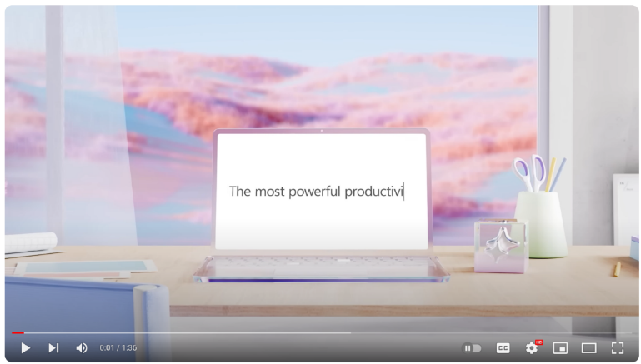

Microsoft Copilot
2021 GitHub Copilot
February 1: Bing Chat
September 26 : Windows 11 Copilot
November 1: Microsoft Office 365 Copilot:
Introducing Microsoft 365 Copilot | Your Copilot for Work - YouTube

Slide 5
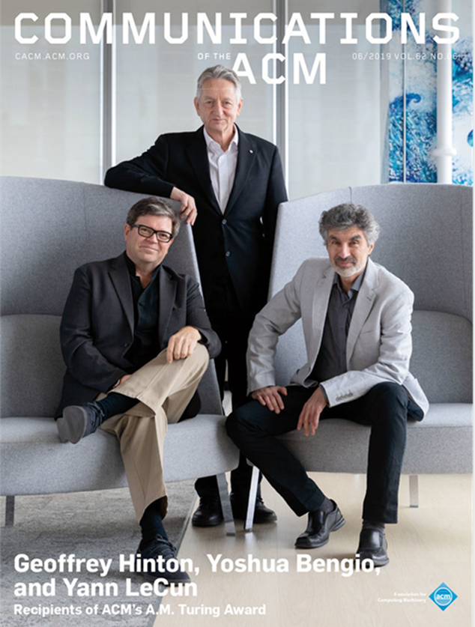
The rise of deep learning 2012-2022
2012: AlexNet wins the ImageNet Large Scale Visual Recognition Challenge
2014: Introduction of Generative Adversarial Networks (GAN's)
2015: AlphaGo defeats world champion Go, Lee Sedol
2017: Google introduces BERT improving ML translations
2018-2021: Introduction of GPT-2, DALL-E, CLIP, GPT-3, …
2022: DALL-E2, Midjourney, Stable Diffusion, ChatGPT, …

Slide 6
What is ChatGPT?
ChatGPT is a large language model (LLM)
Essentially a machine learning model that learns an algorithm to predict the next word based on many text examples
Based on GPT3.5/GPT4 (Generative Pre-trained Transformer)
Improved version of GPT-3 that “understands” text and program code
Different models for performance, chat, text and code completion
GPT3.5 was trained on 570 GB data from the internet (articles, posts, web pages and books)
Available as
Free version
ChatGPT-plus €23 per month
OpenAI playground (API access):
GPT3.5-turbo API 0,002 dollar per 1.000 tokens, ~700 words
GPT4 API 0,03 dollar per 1.000 tokens, ~700 words

Slide 7
What can ChatGPT do?
Chat. Like a chatbot that…
Assists with writing and brainstorming
Tells riddles, jokes, stories
Plays games
Gives compliments and advise
Helps with filling in forms
But it that can also:
Summarise
Translate
Analyse and structure (unstructured) information
Answer questions (but the answer may not be right)
Assist with software writing and debugging
Generate (anonymous) testdata

Slide 8
What can ChatGPT not do?
REMINDER
use LLMs as
co-pilot
It hallucinates facts
It gives wrong answers
Replies can be biased
Can not act spontaneously (needs to be prompted)
Is not good at making calculations (e.g. 4213x8242)
Is limited to generating text output
Can accidentally reveal sensitive training data
…?

Slide 9

Thoughts on using AI for forensic purposes
Hansken is:
used for investigations, bit
designed for evidentiary use
Evidentiary use is more strict:
Accurate
Repeatable
Reproducible
So algorithms must be:
Explainable
Validated
Deterministic
Not depend on external data
Artificial Intelligence:
Use external data: Training sets
Use external data: Cause bios
Lacks explainability
Use AI for investigative purposes,with
Disclaimer
Education
By the way:
Not all currently used algorithms are good
Data under investigation can results from AI itself
https://blog.ampedsoftware.com/2021/10/05/can-ai-be-used-for-forensics-and-investigations

Slide 10
Hallucinations, data privacy and explainability
Preventing hallucinations:
Provide clear prompts to ChatGPT to base its response on digital traces
ChatGPT should not hallucinate but inform that there are no relevant traces
Retrieval-Augmented-Generation (RAG) comes to the rescue
Explicit references to the source on which a response is based
Maintaining data privacy:
Digital traces and case specific details can not be send to the public cloud (e.g., ChatGPT in the OpenAI cloud)
Powerfull Large Language Models can already be deployed on premise (e.g., Meta’s Llama 2)
Assumption: Open source LLMs with RAG do not need the extensive factual knowledge as ChatGPT/GPT-4
Explaining responses:
Identify the sources that were retrieved as part of the RAG method to explain the response
Reproducability over creativity (experiment with “temperature” of the LLM)

Slide 11

Topics for future work
Can we do this off-line with the same quality?
Build a co-pilot in Hansken leveraging Retrieval Augmented Generation (RAG)
Evaluate with (real) users
Advanced topics:
Multi-modal generative transformers (Visual ChatGPT)
Augmented language models
Planning an investigation
Midjourney prompt: Looking in a crystal ball seeing the future of artificial intelligence, ultra HD, super realistic, cinematic lighting. (fast)

Slide 12
How smart are LLMs?
Model | Score
garage-bAInd/Platypus2-70B-instruct | 73.13
upstage/Llama-2-70b-instruct-v2 | 72.95
fangloveskari/Platypus_QLoRA_LLaMA_70b | 72.94
yeontaek/llama-2-70B-ensemble-v5 | 72.86
TheBloke/Genz-70b-GPTQ | 72.82
TheBloke/Platypus2-70B-Instruct-GPTQ | 72.81
psmathur/model_007 | 72.72
yeontaek/llama-2-70B-ensemble-v4 | 72.64
psmathur/orca_mini_v3_70b | 72.64
ehartford/Samantha-1.11-70b | 72.61
MayaPH/GodziLLa2-70B | 72.59
psmathur/model_007_v2 | 72.49
chargoddard/MelangeA-70b | 72.43
ehartford/Samantha-1.1-70b | 72.42
psmathur/model_009 | 72.36
Hugging Face open LLM leaderboard:
https://huggingface.co/spaces/HuggingFaceH4/open_llm_leaderboard
Score gebaseerd op:
ARC: Abstraction en Reasoning Challenge
HellaSwag: een benchmark die zich richt op gezond verstand redeneren
MMLU: Massive Multitask Language Understanding
TruthfulQA: een benchmark die beoordeelt of een taalmodel waarheidsgetrouwe antwoorden genereert

Slide 13
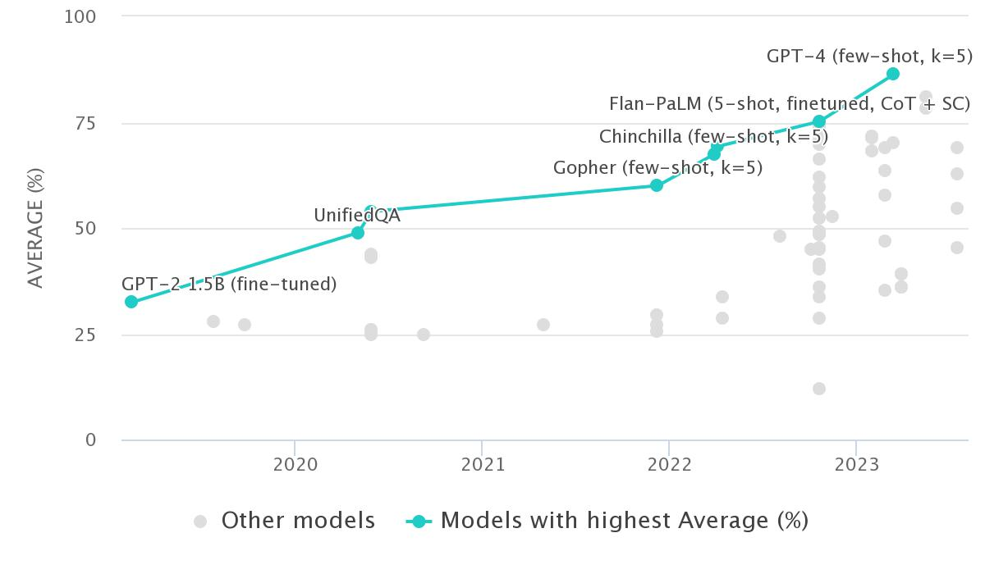
MMLU 2019-2023
Llama 2 70B
Llama 2 35B
Llama 2 13B
Llama 2 7B
https://paperswithcode.com/sota/multi-task-language-understanding-on-mmlu

Slide 14
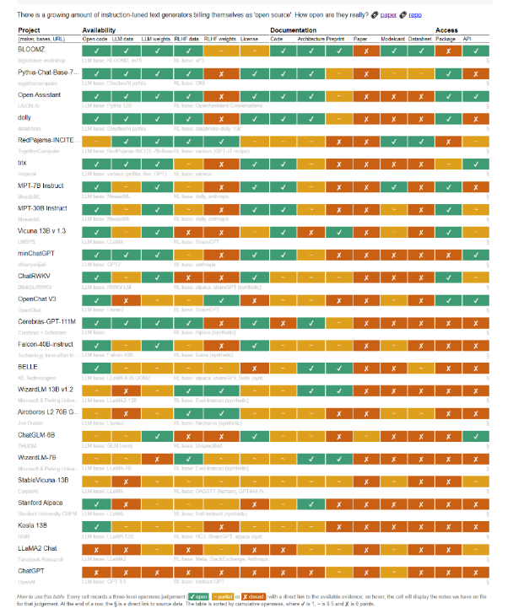
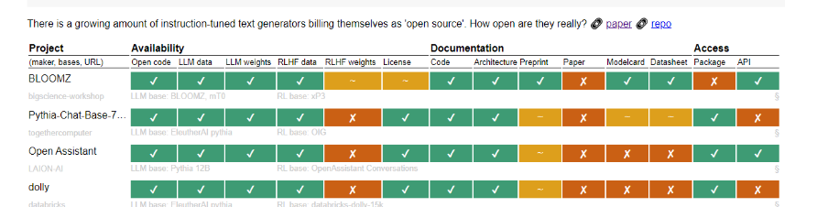
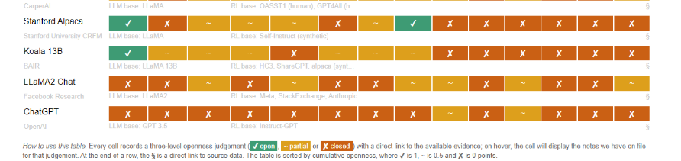
How open are LLMs?
Researchers from Nijmegen University:
Opening up ChatGPT: tracking "open source" LLM + RLHF architectures
https://opening-up-chatgpt.github.io/

Slide 15
Agenda
Time | Title
9:30 | Extra: Introduction to Neural Networks and Natural Language Processing
11:00 | Break
11:30 | Part I: Introduction Large Language Models
12:00 | Part II: Hands-on prompt engineering for digital forensics
12:30 | Lunch
14:00 | (part II continued)
14:30 | Part III: Hands-on with a LLM in a Google Colab notebook
15:30 | Break
16:00 | Part IV: Hands-on with Retrieval Augmented Generation
17:00 | End

Slide 16
Hands-on prompt engineering for digital forensics
Part II: Hans Henseler

Slide 17
Github & Google CoLab
Link:
https://github.com/HansHenseler/DFRWS-APAC-LLM-Workshop
Notebooks:
Part II: Prompt engineering with ChatGPT for Digital Forensics
Part III: Handson with Llama2
Part IV: Retrieval Augmented Generation with Llama2
Requirements:
Google CoLab is free but you need a Gmail account!
Account for accessing free version of OpenAI ChatGPT
Make sure to select a T4 GPU

Slide 18
Reductive operations
Summarization — Say the same thing with fewer words. Can use list, notes, executive summary.
Distillation — Purify the underlying principles or facts. Remove all the noise, extract axioms, foundations, etc.
Extraction — Retrieve specific kinds of information. Question answering, listing names, extracting dates, etc.
Characterizing — Describe the content of the text. Describe either the text as a whole, or within the subject.
Analyzing — Find patterns or evaluate against a framework. Structural analysis, rhetorical analysis, etc
Evaluation — Measuring, grading, or judging the content. Grading papers, evaluating against morals
Critiquing — Provide feedback within the context of the text. Provide recommendations for improvement

Slide 19
Transformative Operations
Reformatting — Change the presentation only. Prose to screenplay, XML to JSON.
Refactoring — Achieve same results with more efficiency. Say the same exact thing, but differently.
Language Change — Translate between languages. English to Russian, C++ to Python.
Restructuring — Optimize structure for logical flow, etc. Change order, add or remove structure.
Modification — Rewrite copy to achieve different intention. Change tone, formality, diplomacy, style, etc.
Clarification — Make something more comprehensible. Embellish or more clearly articulate.

Slide 20
Generative (Expansion) Operations
Drafting — Generate a draft of some kind of document. Code, fiction, legal copy, KB, science, storytelling.
Planning — Given parameters, come up with plans. Actions, projects, objectives, missions, constraints, context.
Brainstorming — Use imagine to list out possibilities. Ideation, exploration of possibilities, problem solving, hypothesizing.
Amplification — Articulate and explicate something further. Expanding and expounding, riffing on stuff.

Slide 21
Prompt engineering with ChatGPT for DF
Our 4 case study experiments:
Writing search queries
Summarising chat conversations
Analysing search results
Reverse engineering
Part II Colab we will focusses on #1, #3 and #4
Midjourney prompt: photorealistic picture of a digital sleuth in the style of Sherlock Holmes as a robot investigating a crime scene with digital traces in smartphones and computers (fast)

Slide 22
More on prompt engineering
Videos and articles by David Shapiro:
https://medium.com/@dave-shap/become-a-gpt-prompt-maestro-943986a93b81
On YouTube: https://www.youtube.com/watch?v=aq7fnqzeaPc
About System Prompts: https://www.youtube.com/watch?v=oILYjtbmLgc&t=760s
Video and notebook by AssemblyAI:
Prompt Engineering 101
https://www.youtube.com/watch?v=aOm75o2Z5-o
Prompt_Engineering_101.ipynb
https://colab.research.google.com/drive/1lHd9b8C4ccAGpkK06dzcFB0asjXWGZi0

Slide 23
Exercise II: prompt engineering & ChatGPT 3.5
Link:
https://github.com/HansHenseler/DFRWS-APAC-LLM-Workshop
Notebooks:
Part II: Prompt engineering with ChatGPT for Digital Forensics
Part III: Handson with Llama2
Part IV: Retrieval Augmented Generation with Llama2
Requirements:
You need to have an account to chat with ChatGPT 3.5 (free)
You can open the notebook in Google CoLab for better navigation

Slide 24
Lunch 12:30-14:00 (part II continues after)
Time | Title
9:30 | Extra: Introduction to Neural Networks and Natural Language Processing
11:00 | Break
11:30 | Part I: Introduction Large Language Models
12:00 | Part II: Hands-on prompt engineering for digital forensics
12:30 | Lunch
14:00 | (part II continued)
14:30 | Part III: Hands-on with a LLM in a Google Colab notebook
15:30 | Break
16:00 | Part IV: Hands-on with Retrieval Augmented Generation
17:00 | End

Slide 25
Agenda
Time | Title
9:30 | Extra: Introduction to Neural Networks and Natural Language Processing
11:00 | Break
11:30 | Part I: Introduction Large Language Models
12:00 | Part II: Hands-on prompt engineering for digital forensics
12:30 | Lunch
14:00 | (part II continued)
14:30 | Part III: Hands-on with a LLM in a Google Colab notebook
15:30 | Break
16:00 | Part IV: Hands-on with Retrieval Augmented Generation
17:00 | End

Slide 26
Hands-on with a local LLM in a Google Colab notebook
Part III: Victor C.W. Cheng and Hans Henseler

Slide 27

Part III: Hands-on with a LLM in a Google Colab notebook
October 2023

Slide 28
How to get LLMs
Subscribe to OpenAI GPT4, Google PaLM
Models are generally more powerful (Higher scores in various assessments)
No need to setup and maintain the models and hardware
Need to pay
Privacy problems
Setup a local in-house LLM
Many models are free
No privacy issue
Mid range hardware required
Self maintenance (very limited support from publishers)

Slide 29
Local LLMs
What Hardware
is required?
What
Models
to be used?
What Hardware
is required?
What
Models
to be used?

Slide 30
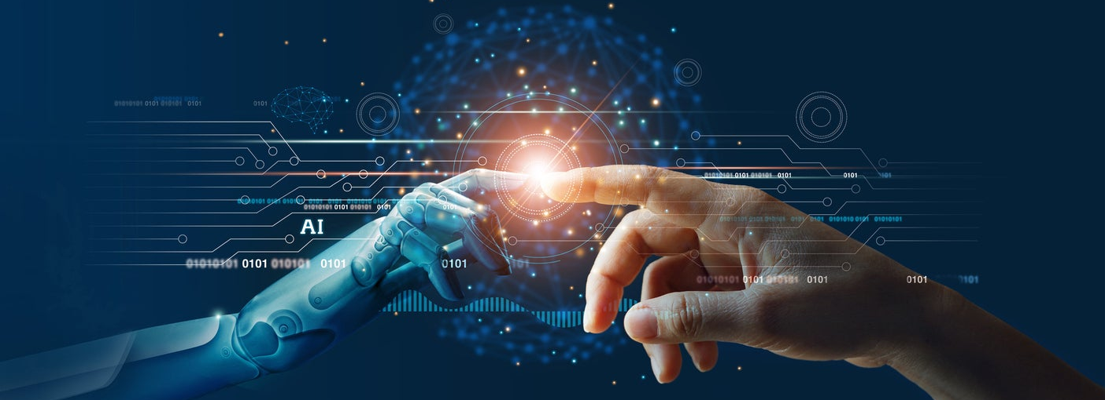
Background Info for Model Selection

Slide 31
Background Info for Model Selection
What do LLMs perform?
Generate coherent text (semantically related text) which can delivery meaningful contents.
$$P(w_{n}|w_{n−1},w_{n−2},…,prompt)$$
Words are probabilistically generated one by one: depending on the previous generated words and the user given “prompt”. Different LLMs have different probability distribution functions!!!

Slide 32
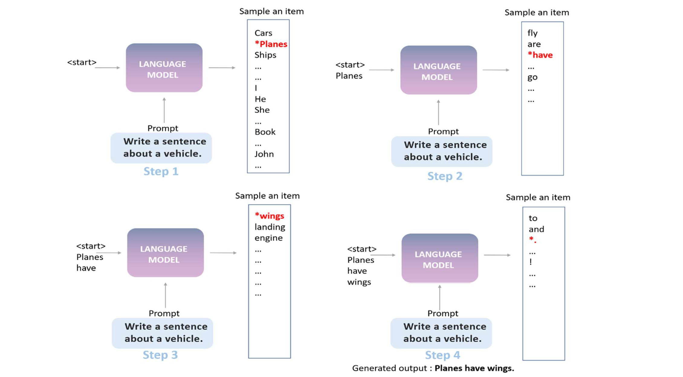
An example illustrating how LLMs generate words using the prompt: “Write a sentence about a vehicle.”
0.4
0.2
0.1
…
…
…
…
…
…
…
…
…
…
…
…
…
…
…
…
…
…
…
…
…

Slide 33
Important Parameters for Local LLMs
Top_k | Only consider the top k words
Top_p | Only consider the top words having total probabilities ≤ Top_p
Temperature | Higher value → more diverse and creative content, but content may not be coherent or even irrelevant
n_ctx, max_length | Max. context length
Max_new_tokens | Max. number of tokens to be generated
Repeat_penalty | Discourage repetitive or redundant output

Slide 34
Local LLM Selection
Features of local LLMs to be considered:
Size of the models (num. of parameters/weights) | 7B, 13B, 30B, etc. Larger size models usually give better performance but require better hardware and slower
Nature of the models | Use instruct model or chat models for Q&A and Retrieval Augmented Generation (RAG)
Weight Quantization | Usually map floating point values (16bits/32bits) to integer values (int8, int4, etc)
Model Data Format/Structure | Hugging Face, GGUF, GGML (now replaced by GGUF), GPTQ, AWQ
Context length (tokens) | 2K, 4K, 8K, 32K…. ChatGPT : 8K, GPT4: 32K Number of context words ~ (0.6 or 0.7) * number of tokens

Slide 35


Parameter Quantization
Models are too big!
High VRAM GPU cards are too expensive! Almost no competitor !!!
Limited supply of high VRAM GPUs
Model computation is slow!
How to make models smaller, while preserving the number of parameters/weights, or minimizing the degradation of performance?
Use smaller number of bits to store the parameters/weights
Float32, float16 ---→ int8 (8-bit integer), int4, …
Faster computation

Slide 36
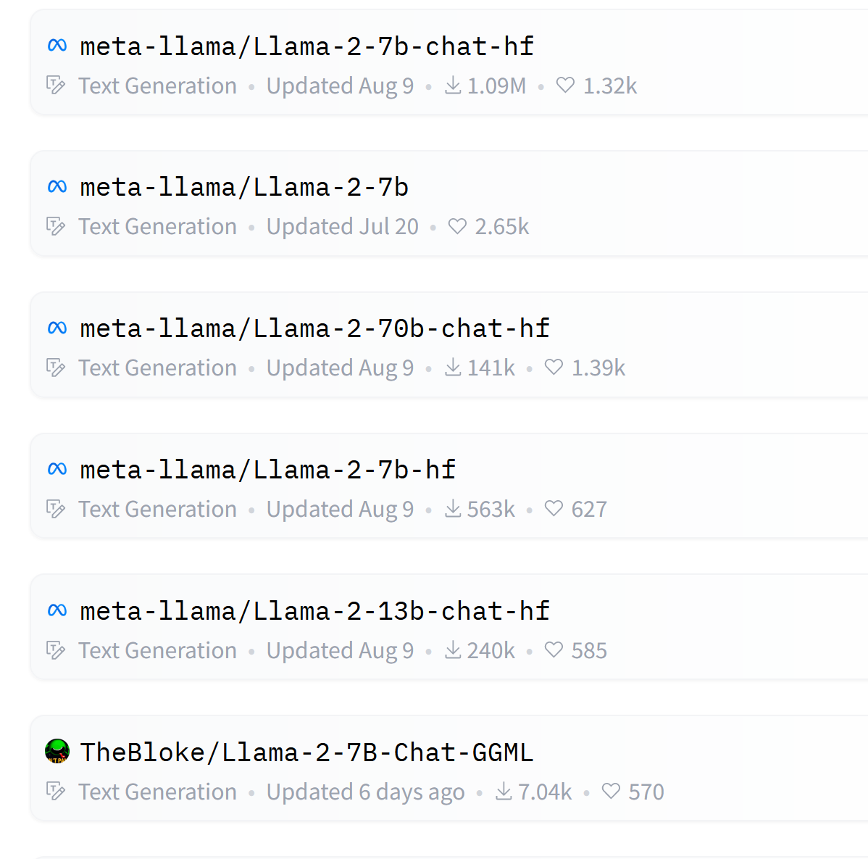
Frameworks
Publisher/model-name model-size model-type framework context-size
Hugging Face: Traditional framework
GGUF/GGML: Optimized for CPU and (CPU + GPU)
GPTQ: Optimized for GPU and (GPU + CPU)
AWQ: Recent efficient quantization method (size, speed)

Slide 37
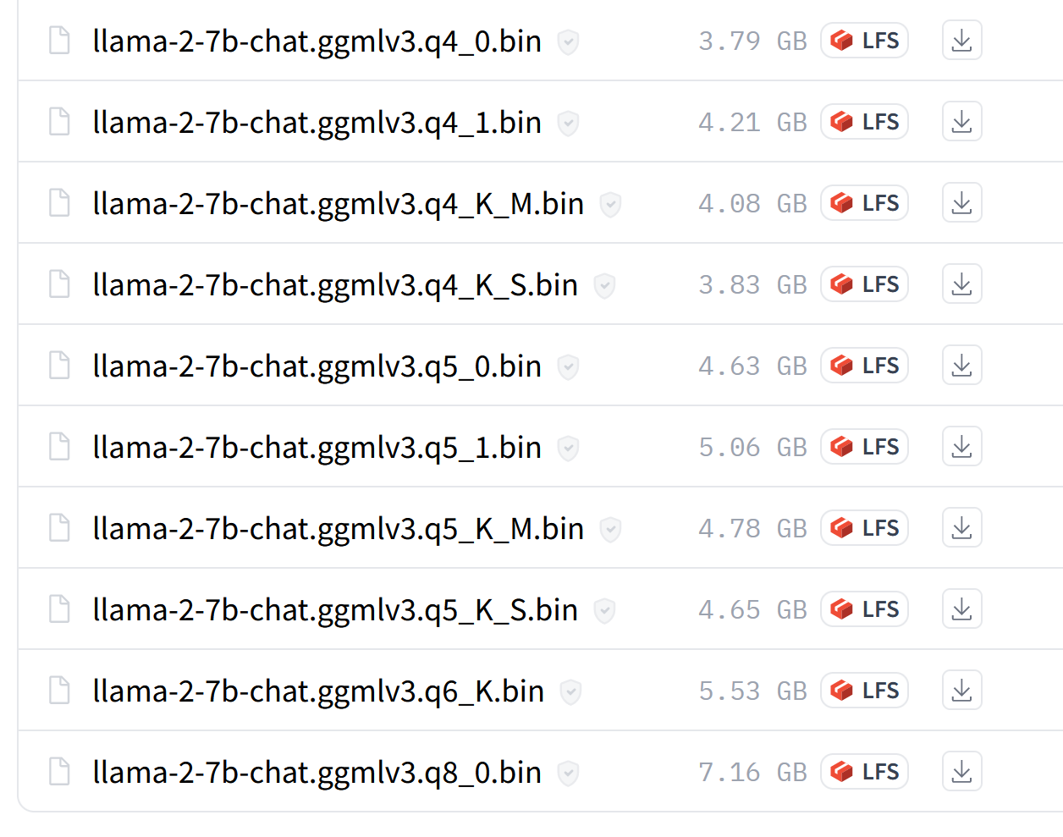
For example:
Llama 2 7B chat model
No. of parameters: 7B (float 16)
Memory required: ~ 14GB
Q4_0: 4bit quantization
7B parameters ~ 3.5GB
Q5_0: 5bit quantization
7B parameters ~ 4.4GB
Q6_K_S: 6bit K-quantization
7B parameters ~ 5.3GB
Q8_0: 8bit quantization
7B parameters~ 7.0GB

Slide 38
Exercise III: Hands on with Llama2
Link:
https://github.com/HansHenseler/DFRWS-APAC-LLM-Workshop
Notebooks:
Part II: Prompt engineering with ChatGPT for Digital Forensics
Part III: Hands on with Llama2
Part IV: Retrieval Augmented Generation with Llama2
Requirements:
Google CoLab is free but you need a Gmail account!
Make sure to select a T4 GPU

Slide 39
Agenda
Time | Title
9:30 | Extra: Introduction to Neural Networks and Natural Language Processing
11:00 | Break
11:30 | Part I: Introduction Large Language Models
12:00 | Part II: Hands-on prompt engineering for digital forensics
12:30 | Lunch
14:00 | (part II continued)
14:30 | Part III: Hands-on with a LLM in a Google Colab notebook
15:30 | Break
16:00 | Part IV: Hands-on with Retrieval Augmented Generation
17:00 | End

Slide 40
Hands-on with a LLM in a Google Colab notebook
Part III continued

Slide 41
Agenda
Time | Title
13:00 | Part I: Introduction Large Language Models
13:45 | Part II: Hands-on prompt engineering for digital forensics
14:30 | Part III: Hands-on with a LLM in a Google Colab notebook
15:00 | Break
15:30 | Part III continued
16:00 | Part IV: Hands-on with Retrieval Augmented Generation
16:30 | Panel discussion on LLMs in the legal domain
17:00 | End

Slide 42
Hands-on with Retrieval Augmented Generation
Part IV: Victor C.W. Cheng and Hans Henseler

Slide 43
Part IV: Hands-on with Retrieval Augmented Generation (RAG)

Slide 44
GGML/GGUF models are a good choice if no good GPU, but good CPU & 16GB RAM required
optimized for CPU execution
No GPU
Small GPU card
(e.g. 4GB or 6GB VRAM)
off load part of the model weights/layers to GPU
highly increase the word generation speed, compared to no off loading.
Larger GPU card
(e.g. 16GB VRAM)
can consider GPTQ models which are optimized for GPU execution and usually have slightly smaller sizes compared with GGML/GGUF models.
Using original models (no quantization) say 13B (26GB) or 30B (60GB) models, or
Larger size models* (with quantization) say 70B models (36GB with 4bit quantization).
Huge GPU
(e.g. V100 36GB, A100 40GB/80GB)
* Option 2 usually gives better performance.

Slide 45
Background
LLMs are pretrained with public domain information.
Public information may not be up-to-date and less accurate.
Embedding new/unseen information after pretraining is difficult.
“Hallucination” may happen and hard to detect
Resolution:
Fine tuning with new information or new tasks
Embed the new information to the LLM input prompts (known as context) and instruct LLMs to respond based on the context, known as retrieval augmented generation (RAG).
Can be regarded as open book Q&A

Slide 46
Background
RAG enable up-to-date and private information to be analyzed or processed by LLMs
Hallucination is less probable (still be possible)
Source of information can be identified and hence LLM’s responses can be checked (but still need manual efforts), hence verifiable.
No training or fine-tuning, thus low cost and time saving.
RAG has 2 stages:
1. Retrieval stage: search for relevant information
2. Generation stage: Generate answers to the user questions

Slide 47
Large information sources
Cannot pass huge size passages/documents to LLMs, due to limited context length they can handle, e.g. GPT4: 32K tokens, Llama 2: 4K tokens.
Most LLMs only accept text format information.
If too many documents or the document is too large, split them into individual overlapping chunks of text.
Hence,
Step 1: Identify relevant chunks of text.
Step 2: Create a prompt to include the relevant chunks together with the user query and send to the LLM.

Slide 48
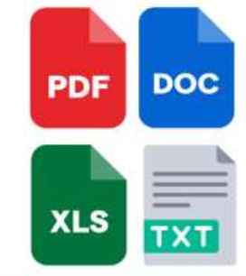
Identify Relevant Chunks
Each chunk is represented by a vector
e.g., FAISS, Chroma
Embedding Model
Vector store
Extract text and split the text into overlapping chunks
e.g. sentence-transformer
Store vectors, text chunks, metadata
Document repository
Preprocessing
Embedding Model
User query
Query vector
Vector store
Relevant text chunks
Inference

Slide 49
Create prompt and get responses
Prompt template:
Based on the context to answer the question.
Context: {context}
Question: {question}
Prompt:
Based on the context to answer the question.
Context: Relevant text chunks
Question: User query
Prompt:
Based on the context to answer the question.
Context: Relevant text chunks
Question: User query
LLM
(e.g. Llama 2)
Relevant text chunks
LLM
(e.g. Llama 2)
User query
Answer

Slide 50
Challenges
Selection of correct chunks is extremely important → incorrect chunks will result in inaccurate answers or no answer at all.
If queries involve information spanning several chunks, selecting the correct chunks becomes very difficult.
Tables, especially those extracted from PDFs, can be challenging for LLMs to comprehend.
Most local LLMs currently lack support for images.

Slide 51
Exercise IV: RAG with Llama2
Link:
https://github.com/HansHenseler/DFRWS-APAC-LLM-Workshop
Notebooks:
Part II: Prompt engineering with ChatGPT for Digital Forensics
Part III: Handson with Llama2
Part IV: Retrieval Augmented Generation with Llama2
Requirements:
Google CoLab is free but you need a Gmail account!
Make sure to select a T4 GPU

Slide 52
Question and Discussion
Victor C.W. Cheng and Hans Henseler

Slide 53
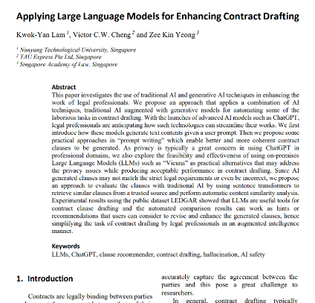
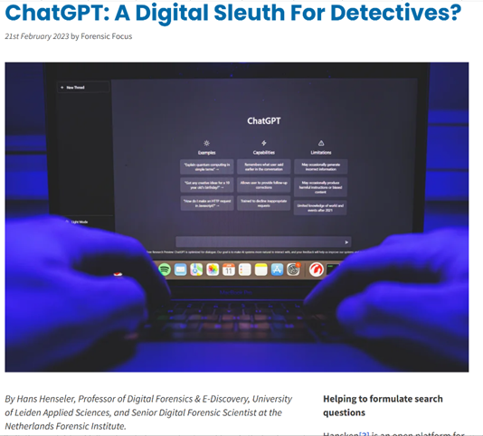
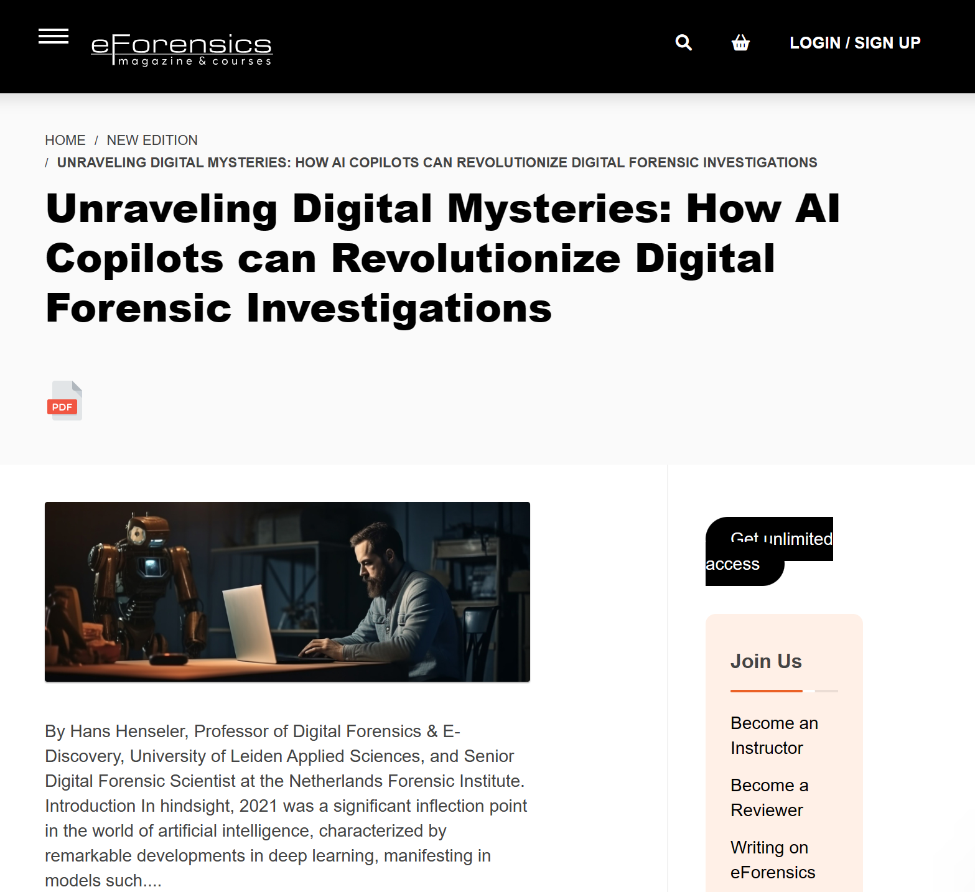
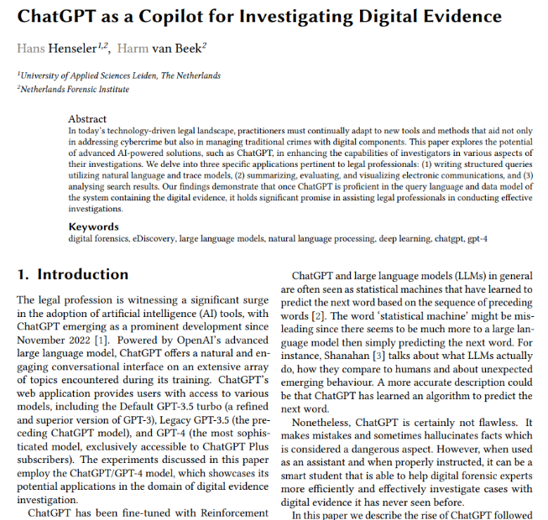
Thank you!
Hans Henseler
h.henseler@nfi.nl
Kwok-Yan Lam
kwokyan.lam@ntu.edu.sg
Zee Kin Yeong
Yeong_zee_kin@sal.org.sg
Victor C.W. Cheng
victor.cheng@tauexpress.com
Published papers and articles:
https://www.forensicfocus.com/articles/ chatgpt-a-digital-sleuth-for-detectives
https://eforensicsmag.com/unraveling-digital-mysteries-how-ai-copilots-can-revolutionize-digital-forensic-investigations/
https://ceur-ws.org/Vol-3423
https://ceur-ws.org/Vol-3423

